Slide 1
Netflix Customer Care Number Australia
+61-180-086-8603 - Helpdesk Support

Slide 2
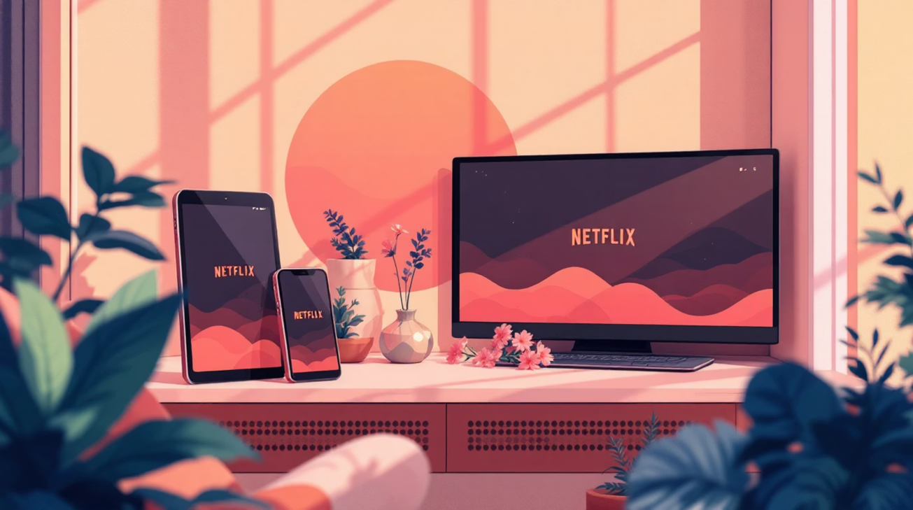

About Netflix
Netflix is one of the most popular online streaming platforms, providing movies, TV shows, web series, and Netflix Originals.
This subscription-based service is accessible on multiple devices, serving millions of users worldwide who rely on Netflix for entertainment.
https://www.helpdesk-australia.com/blog/netflix-support-number-australia.html
Notes:
2

Slide 3




Common Netflix Issues
Error Codes
Login Problems
NW-2-5, 12001, 1001, 40104, 5009, 5403, 11853, 1011
Unable to access account or sign in
Black Screen
App Crashing
Video not displaying properly
Application not loading or freezing
https://www.helpdesk-australia.com/blog/netflix-support-number-australia.html
Notes:
3

Slide 4
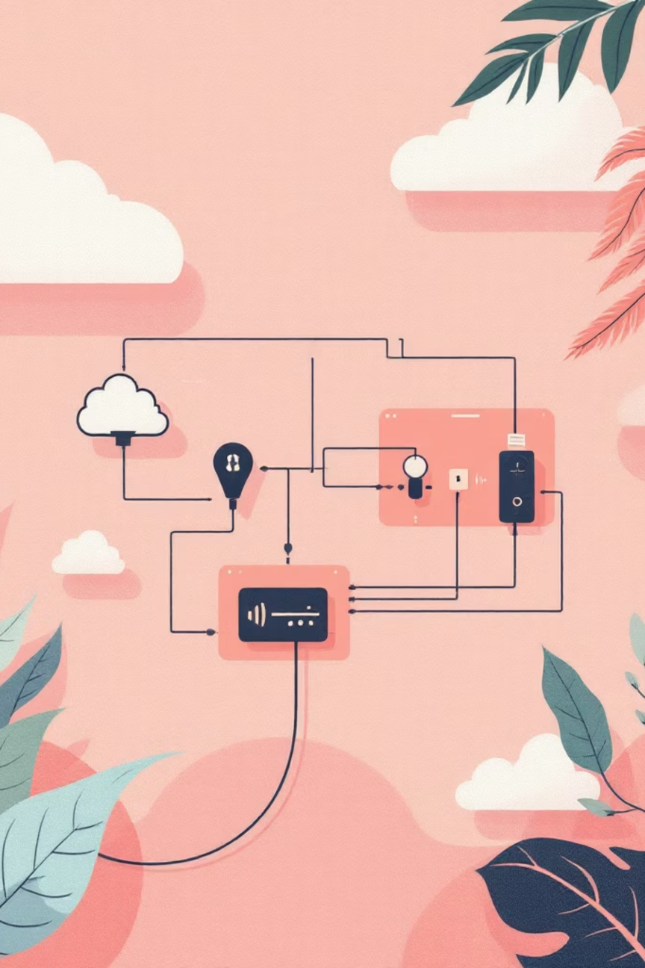





Causes of Netflix Problems
Poor Internet
Weak or unstable connection
Device Issues
Compatibility problems
Configuration
App settings misconfigured
Account Settings
Profile or subscription issues
https://www.helpdesk-australia.com/blog/netflix-support-number-australia.html
Notes:
4

Slide 5



Netflix Customer Support Assistance
Get help when facing issues while streaming content. Our support team is available 24/7 to assist you.
Phone Support
Live Chat
Email Assistance
Speak directly with our technical experts
Instant response and real-time problem solving
Detailed support for complex issues
https://www.helpdesk-australia.com/blog/netflix-support-number-australia.html
Notes:
5

Slide 6
Issues We Help Solve
Download Problems
Connection Issues
Unable to download movies or shows for offline viewing
Netflix not connecting to Wi-Fi or network
Streaming Errors
Password Reset
Video playback problems and buffering issues
Resetting Netflix account password
Installation Support
Subscription Help
Activation and billing problems
Netflix setup and installation issues
https://www.helpdesk-australia.com/blog/netflix-support-number-australia.html
Notes:
6

Slide 7

Contact Support
📞 Phone
📧 Email
+61-180-086-8603
Send detailed inquiries and receive comprehensive assistance
Netflix Customer Care Number Australia
💬 Live Chat
Quick troubleshooting and instant customer assistance
https://www.helpdesk-australia.com/blog/netflix-support-number-australia.html
Notes:
7

Slide 8
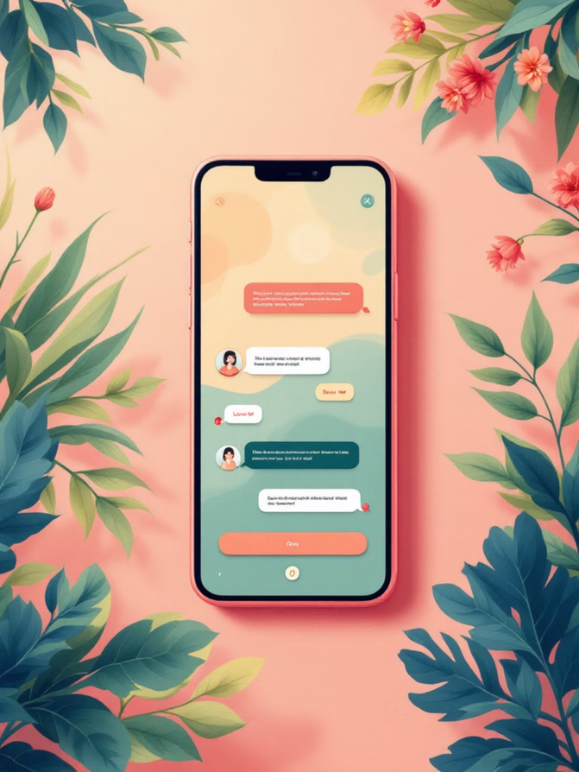
How Live Chat Works
Real-Time Solutions
01
Instant Response
02
Connect immediately with our support team
Get problem-solving as it happens
Easy Communication
03
Discuss account or technical issues seamlessly
https://www.helpdesk-australia.com/blog/netflix-support-number-australia.html
Notes:
8

Slide 9





Why Choose Us
Fast Troubleshooting
Skilled Technicians
Years of Experience
Trained professionals ready to help
Proven track record in technical support
Quick solutions to get you streaming
24/7 Assistance
Reliable Help
Always available when you need help
Trusted customer support service
https://www.helpdesk-australia.com/blog/netflix-support-number-australia.html
Notes:
9

Slide 10


About Help Desk Australia
Important Disclaimer
We are an independent third-party service provider offering support and guidance for users facing Netflix-related issues.
This service is not directly affiliated with Netflix.
Help Desk Australia provides technical and customer support services for streaming platforms including Netflix, offering troubleshooting and assistance for common issues.
https://www.helpdesk-australia.com/blog/netflix-support-number-australia.html
Notes:
10

Slide 11

Netflix Customer care Number Australia
Helpdesk Support & Troubleshooting Guide
📍 33 Woodwark Crescent, Silver Valley, Australia
📞 +61-180-086-8603
Australia Help Desk
https://www.helpdesk-australia.com/blog/netflix-support-number-australia.html
Notes:
1

Slide 12
Thank You !

